Slide 1


Introduction to Software Business Product Management
Week 2 Day 3
Led by: Emily Crose
for
Oakland University

Slide 2
Day 2 Recap

Slide 3

Questions From Day 2?

Slide 4
Terms To Listen For
Discretionary Access Control (DAC)
A method of access control provisioned by an administrator
Mandatory Access Control (MAC)
Access control provisioned by data labeling
Authentication
Refers to the process of verifying a user’s identity.
Denial of Service
A forced outage of a service based on a misconfiguration or a concerted effort

Slide 5


Authentication

Slide 6
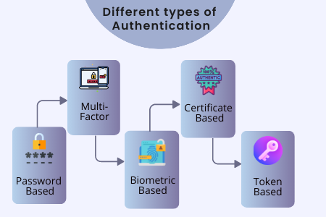

Slide 7

Access Control

Slide 8

MAC, DAC, and RBAC

Slide 9

Mandatory Access Control

Slide 10
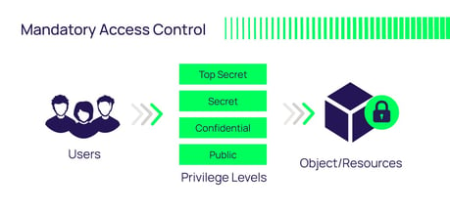
Mandatory Access Control (MAC)
Notes:
The important piece for MAC is that access to a resource is based on the sensitivity label of the information.

Slide 11

Discretionary Access Control (DAC)

Slide 12
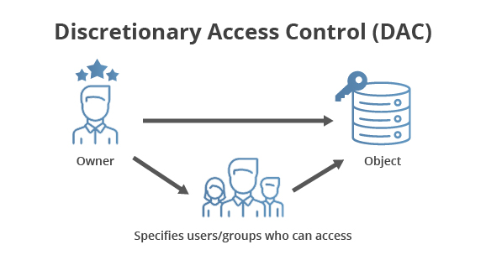
DAC

Slide 13
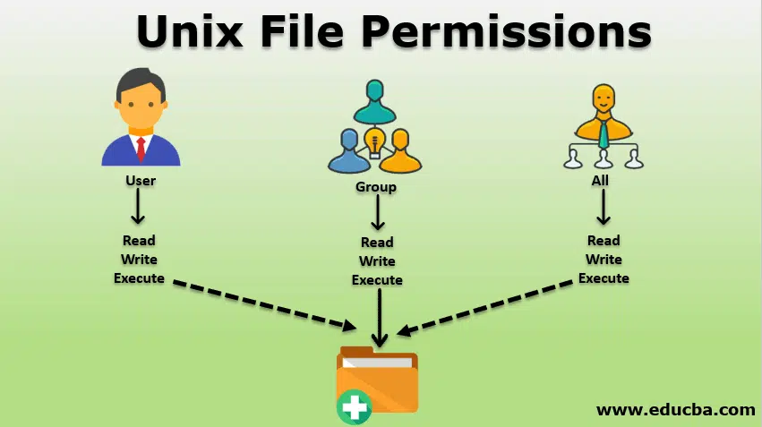
DAC In Action

Slide 14
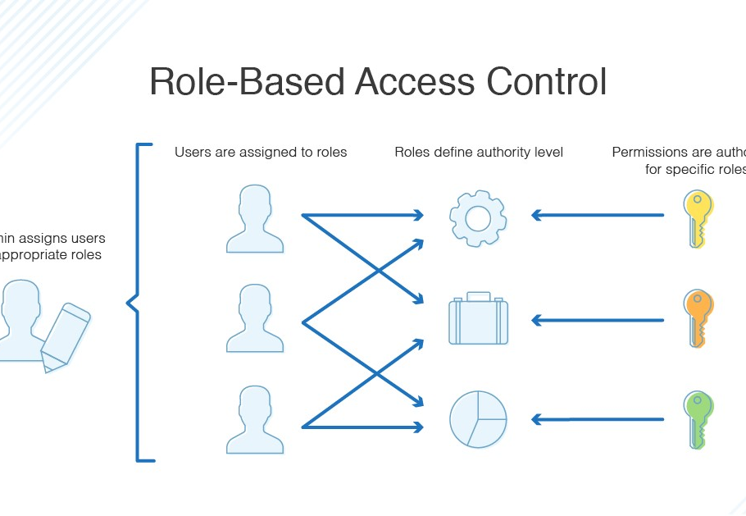
Role Based Access Control (RBAC)

Slide 15
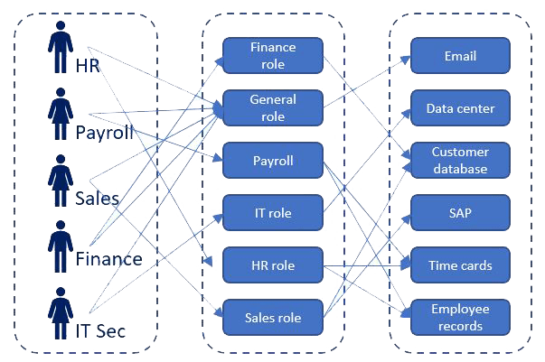
RBAC In Action

Slide 16
Pentesting Methodology

Slide 17
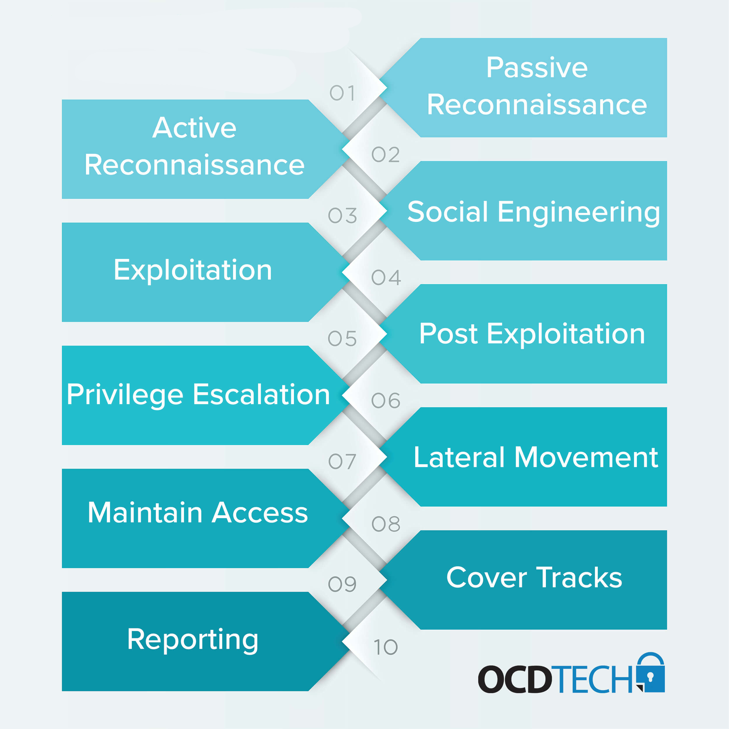

Slide 18
Standards

Slide 19


OWASP

Slide 20
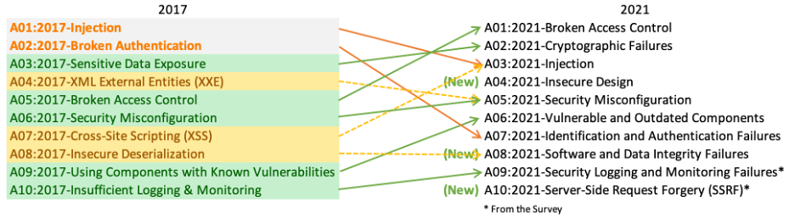
OWASP Top 10

Slide 21

Mobile Application Security Verification Standard (MASVS)
https://github.com/OWASP/owasp-masvs/

Slide 22


Slide 23
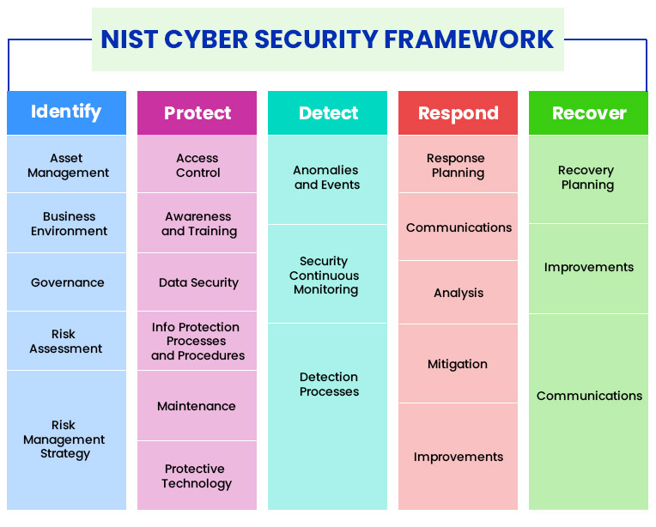
NIST Cybersecurity Framework

Slide 24

10-minute break

Slide 25
Application Programming Interfaces (APIs)
What do they do for applications?
When would we want to use an API?

Slide 26
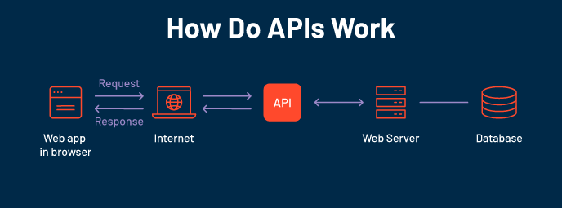

Slide 27
Familiar APIs
Representational State Transfer (REST or RESTful) API
Fast
Reliable
Widely adopted
Simple!
Simple Object Access Protocol (SOAP)
Used in some OT network appliances
Browser API
iOS/Android API
Allows developers the tools they need to utilize local resources in their own programs
Notification API calls
Camera activation
Media integration

Slide 28
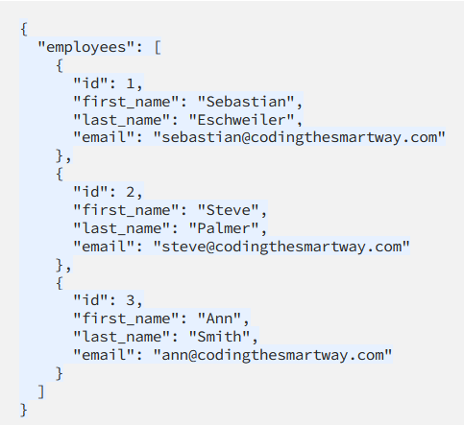
Notes:
Let’s take a look at a JSON form providing us information through an API interface. So when we use an API to retrieve information, we will typically be grabbing that information from a formatted file like a JSON file. We can see from this JSON file that actually this looks kind of like a database file.

Slide 29
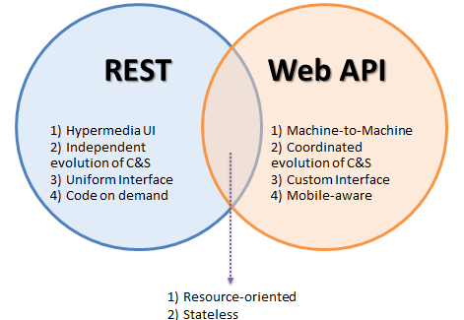
Popular API Frameworks

Slide 30

HTTP/Web API

Slide 31
HTTP API Verbs
HTTP
GET
POST
PUT
DELETE

Slide 32
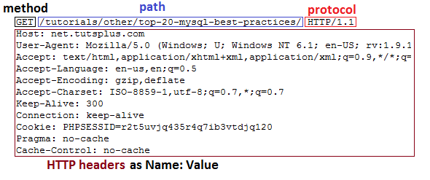
HTTP GET Header

Slide 33
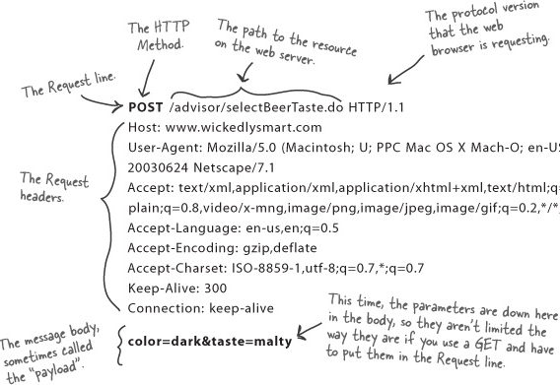
HTTP POST Header

Slide 34
Weather API Documentation
https://rapidapi.com/weatherapi/api/weatherapi-com
Notes:
A word on documentation – we should always start with the documentation when we go to program with an API

Slide 35
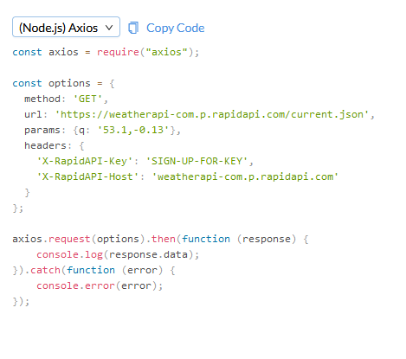
Notes:
So let’s take a look at what an API actually looks like in practice.

Slide 36
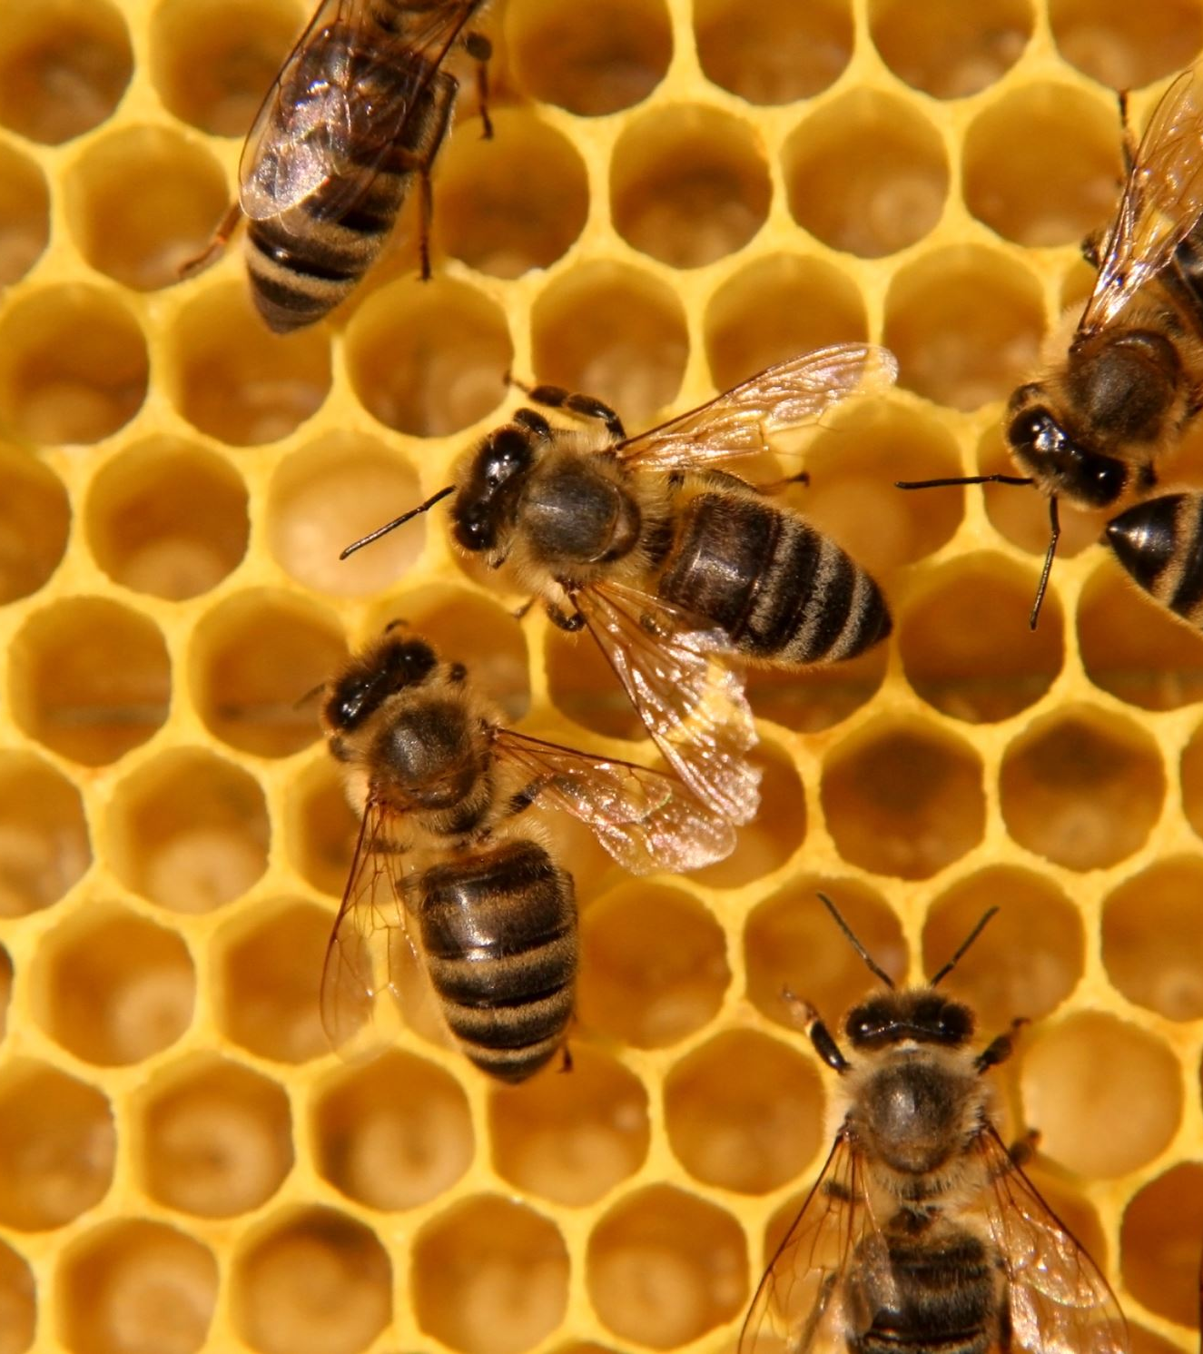
Working With APIs
Can be programmed
Can be used in a raw request

Slide 37
Programming Mobile Apps w/APIs
Android
Kotlin
Apple iOS
SWIFT
Both have access to device APIs!

Slide 38
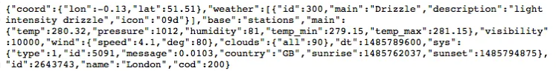
Mobile Device API Example

Slide 39
10 minute break

Slide 40

Securing APIs

Slide 41
SAML vs. Oauth
Security Assertion Markup Language (SAML)
Windows uses this for Single Sign On (SSO)
Integrates with Windows domain
Optimized for enterprise security
Oauth
Optimized for mobile applications
Uses API calls itself!
Tends to play better with mobile & lightweight IoT environments

Slide 42

What is Oauth?

Slide 43
Oauth
Allows one application to validate itself with another application
Uses tokens for authentication
We give applications permission to play with other applications via Oauth
Think of it like a valet for your apps!

Slide 44
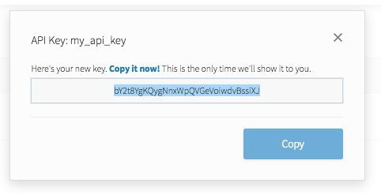
API Key
Notes:
API keys are meant to be kept secret. Why? Because they include information related to one specific account.

Slide 45

Why Do We Need API Keys?
Account verification
Who is requesting what information?
Rate limiting
Avoid denial of service
Permissions
What do we want to allow certain people to see?

Slide 46
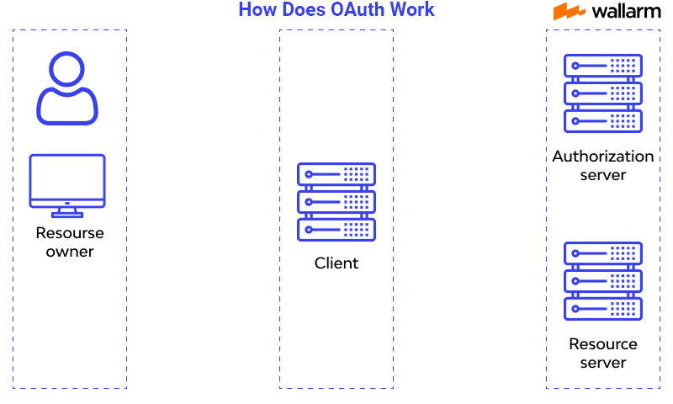
How does OAuth work?

Slide 47

Question or clarifications?

Slide 48

Review Day 3

Slide 49

Preview Week 3

